Slide 1

Identity Federation
Presentation by:
S.Suresh
CloudSIKSHA

Slide 2
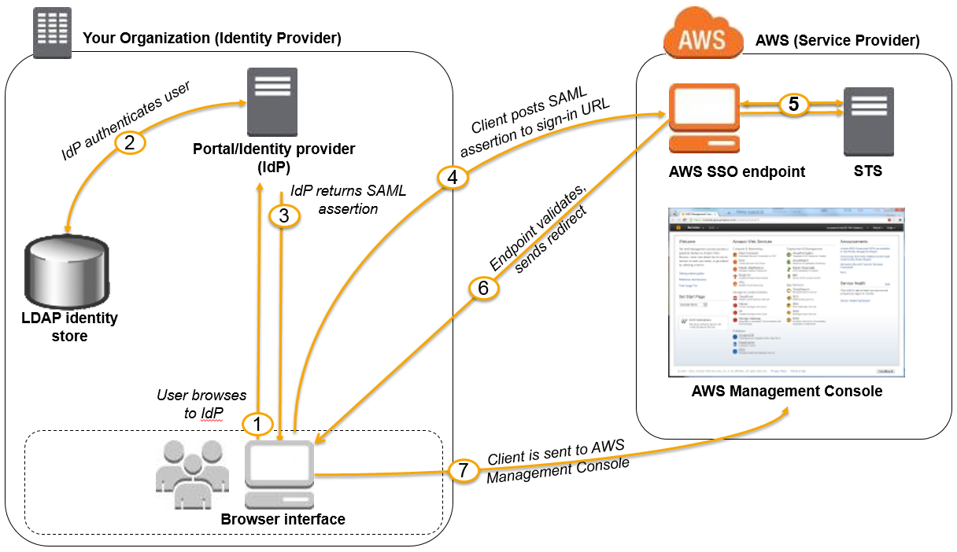
Identity Federation

Slide 3

Thank you

